Slide 1
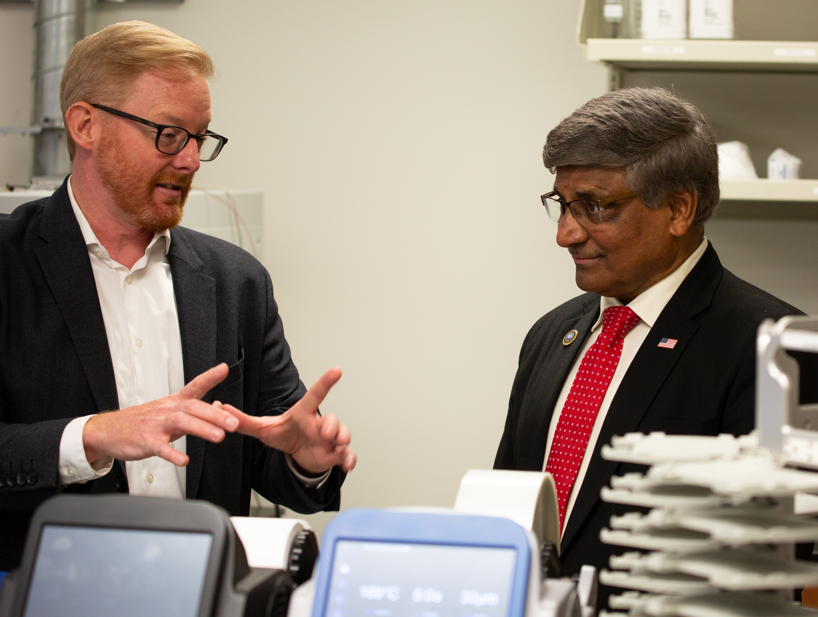
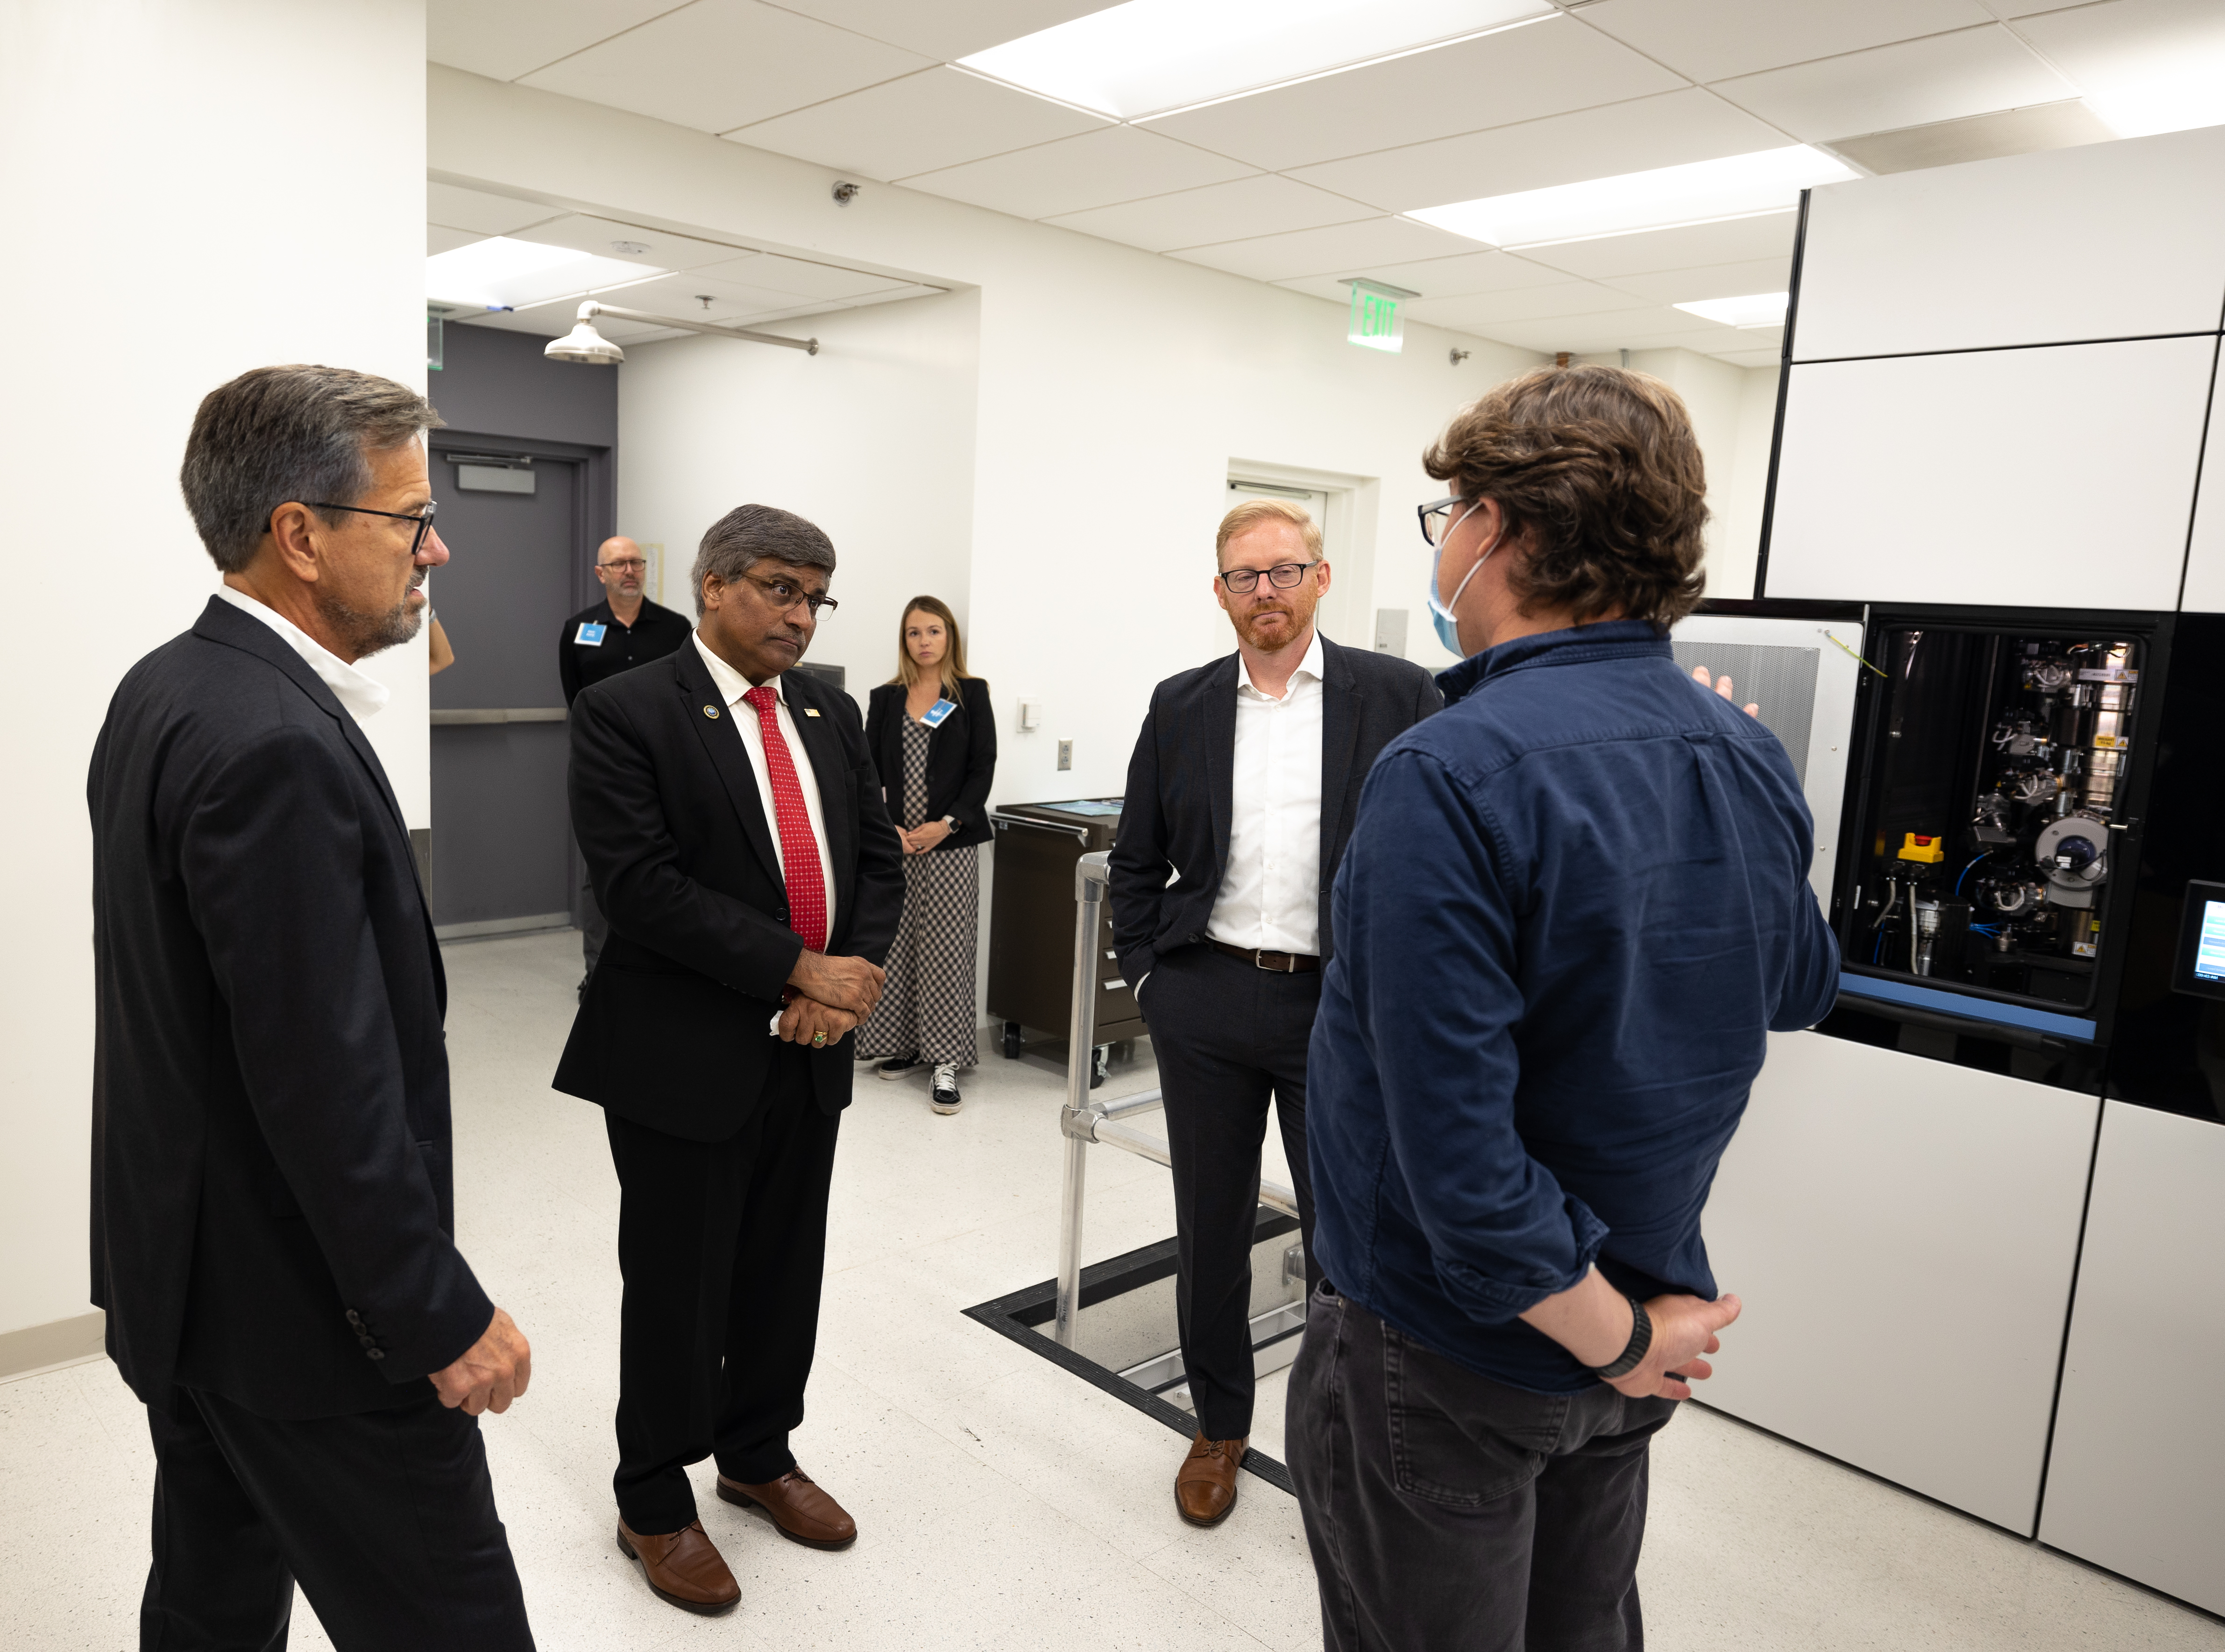
National Science Foundation Director visits BioPACIFIC MIP facilities
BioPACIFIC MIP at UCLA DMR-1933487
2022
University of California Los Angeles
Dr. Sethuraman Panchanathan, Director of the National Science Foundation, visited UCLA on September 14, 2022, to meet with students, faculty members, and campus leaders. Through small group discussions, facility tours, and a public seminar, he offered words of inspiration on how the research community can best influence and guide the next generation of scientists and engineers.
In meetings with different groups throughout the day, Dr. Panchanathan emphasized that accessibility and inclusivity must be at the forefront of all research efforts. He also highlighted the NSF’s commitment to collaboration with other federal agencies, industry partners, cities, states, and countries across the globe to enhance the speed, scale and impact of discovery-driven science.
As part of his visit, Dr. Panchanathan visited the BioPACIFIC Materials Innovation Platform facilities to meet with its leadership and technical staff. He highlighted the importance of open-access research infrastructure and workforce development to the NSF mission, particularly in the context of developing a basic research to commercialization pipeline. He also gave passionate arguments on the need to support and deliver value to individuals, groups, and regions that have been underrepresented in scientific research, which is key component of BioPACIFIC MIP’s core mission.
BioPACIFIC MIP Executive Director Adam Stieg and NSF Director Dr. Panchanathan tour the Living Biofoundry at UCLA, a facility that enables automated synthetic biology and microbial engineering for materials discovery.
(From left to right) CNSI Director Jeff Miller, Dr. Panchanathan, BioPACIFIC MIP Executive Director Adam Stieg and BioPACIFIC MIP Project Scientist Matthew Mecklenburg discuss the BioPACIFIC MIP’s microelectron diffraction facility.
Notes:
Sethuraman Panchanathan, Director of the National Science Foundation, visited UCLA. See https://newsroom.ucla.edu/stories/national-science-foundation-sethuraman-panchanathan-campus-visit
BioPACIFIC MIP, https://biopacificmip.org/, is a Materials Innovation Platform at UCSB and UCLA.

